Slide 1
Analyzing Health Equity Using Household Survey Data
Lecture 3
Health Outcome #1: Child Survival
Notes:
Child mortality is a very commonly used indicator of average population health. Reducing child (under-five) mortality by two-thirds by 2015 is the fourth Millennium Development Goal. Child mortality has been used to measure differences in health between the rich and poor for a very large number of low-income countries using the Demographic and Health Surveys (Gwatkin et al, 2000 and 2007).
The corresponding chapter in AHE is largely concerned with computation of child mortality rates from survey data. This presentation will not cover the programming code required for this computation, which is given in a Stata do file. Rather the focus here will be on the main steps involved in the measurement of child mortality from survey data.

Slide 2
Child mortality
Infant mortality rate (IMR) – no. of deaths in the first year of life per 1000 live births
Under-five mortality rate (U5MR) – no. of deaths in first 5 years per 1000 live births
Notes:
Each measure is an indicator of the probability of a child dying before its first/fifth birthday.
IMR and U5MR can be calculated from vital registration statistics but these are often not comprehensive in coverage in the developing world – births and/or deaths may not be recorded – and they will not usually allowing matching data on birth/death with socioeconomic status in order to measure health inequality.

Slide 3
Data for estimation of child mortality
Vital registration statistics often incomplete, unreliable or not linked to socioeconomic status data
IMR & U5MR estimated from fertility histories in survey data
  Complete fertility history – dates of all births/child deaths to woman of fertile age
  Incomplete fertility history – no. children born to woman and no. still alive
Complete fertility history requires more data but less assumptions and gives standard errors
Incomplete fertility history requires less data but must impose a model life table and does not give standard errors
Notes:
Collection of a complete fertility history is more demanding in terms of the information that must be retrieved from each woman. There is scope for errors to be made in the recollection of dates of birth/death. But it does not require that the survey data be supplemented by projections from model life tables, which may also contain error. And it allows a standard error for the estimated mortality rate to be computed.
This lecture deals with the measurement of child mortality rates from both complete and incomplete fertility histories from survey data.

Slide 4
Computing survival time from complete fertility histories
Create a variable to indicate the interview date (intrvdate2)
Create a vbl to indicate the date-of-birth of each child (dob)
From intrvdate2 and dob, compute the age each child would be at interview if alive (hypagedays)
Choose a reference period for births – 5 or 10 years before interview date – and select on hypagedays accordingly
Create a vbl to indicate vital status of each child (dead)
From hypagedays, dead and date of death compute the survival time of each child until death or interview (timeyears)
Notes:
Mortality rates are usually estimated from data on births that occurred within five or ten years of the date at which the fertility history was recorded. There is a trade-off in the choice of reference period. A longer period will give a larger sample but the data may be more subject to recall error.
In computing date-of-birth we must decide what to do about missing information. Discarding all cases with missing information may lead to downward bias of the estimate of mortality if information is more likely to be missing for children that have died. One approach is to keep all cases that are not missing on year of birth and assign values for the missing day and/or month of birth.

Slide 5
Estimating mortality rates
From hypagedays, dead and timeyears, a life table can be estimated
In Stata,
ltable timeyears dead if hypageyrs <=10 , int(.5) gr
Notes:
1. In the Stata command, children born in the last 10 years are selected and a fixed, half-year interval is used to compute the mortality rates.

Slide 6
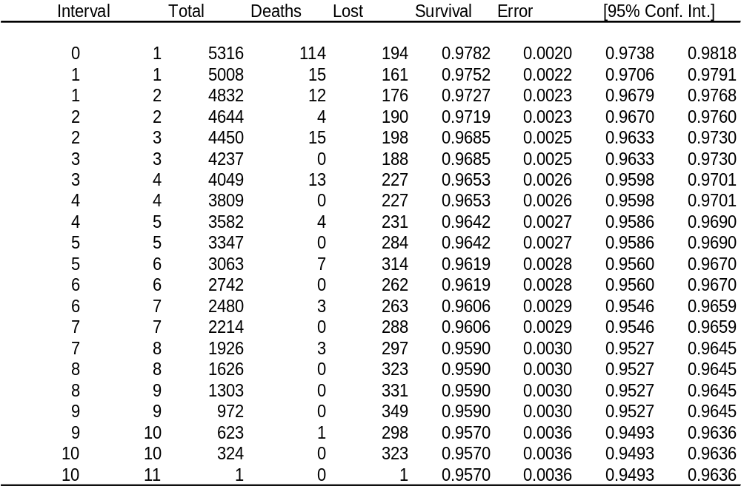
Life Table, Vietnam 1988–98
Notes:
Estimated from the 1998 Vietnam Living Standards Survey.
The first line shows that from a total of 5316 sample births during the 10 years reference period preceding the interview date, there were 114 deaths during the first 6 months of life.
194 were “lost” or censored since they were born less than 6 months before the interview date. The assumption made in the life table is that these 194 children were exposed for only half of the interval—in this case three months rather than six. The total number of children exposed during the first six months is thus 5,316 less half of 194, or 5,219.
The survival rate for the first six months is therefore (5,316 – 114) divided by 5,219, or 0.9782. The survival rate for each of the subsequent half-years is computed in the same way, and from these the cumulative survival function (labeled simply “survival” in the table) is formed.
The IMR is the complement of the cumulative survival function at the end of the first year—that is, 1 ‑ 0.9752, or equivalently 24.8 per 1,000 live births. The U5MR is equal to 1 ‑ 0.9642, or 35.8 per 1,000.
Stata also produces standard errors for the cumulative survival function, which are the standard errors for the IMR and U5MR. For example, the standard error for the IMR is 2.2 per 1,000, or 8.9 percent of the IMR (known in this form as the relative standard error).

Slide 7
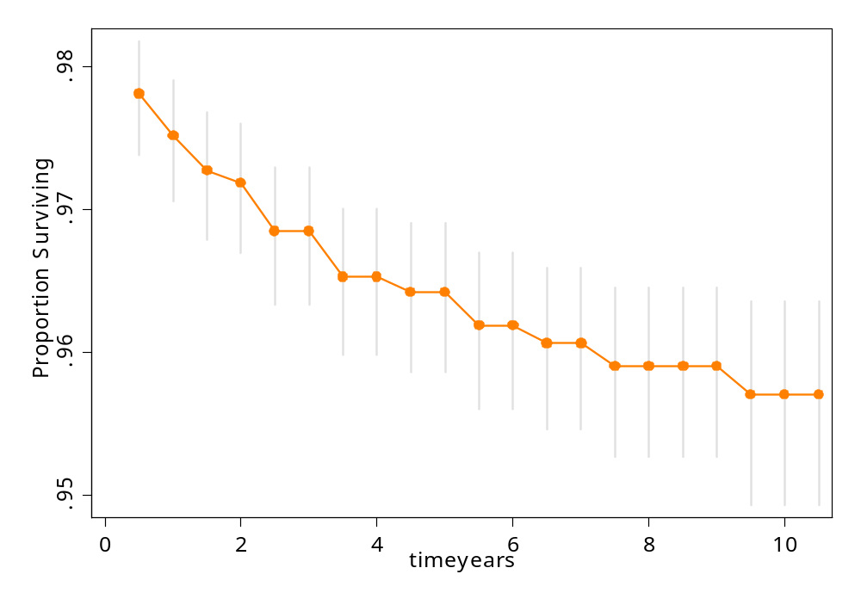
Survival Function with 95 Percent Confidence Intervals, Vietnam 1988–98
Notes:
This Figure is the chart produced by the gr option in the ltable command above—it shows the cumulative survival function and the 95 percent confidence intervals around the point estimates.
Disaggregated analysis—e.g., mortality rates for different wealth groups—is easily undertaken simply by adding to the ltable command a by(variable name) option. This produces as many life tables as there are categories in the stratifying variable.
Sampling weights cannot be used with ltable. Weighted samples can be handled using Stata’s st commands. When the data are declared to be survival data with the stset command, pweights can be specified. The sts list command can be used to generate the life table from which the IMR and U5MR can be read

Slide 8
Indirect mortality estimation from incomplete fertility histories
Incomplete fertility histories give the no. of kids born to each woman and the no. surviving
A model life table is then superimposed on these data to estimate mortality rates
The latter step can be done using QFIVE
QFIVE requires, for each of 7 age groups: # women, # kids born, # kids surviving

Slide 9
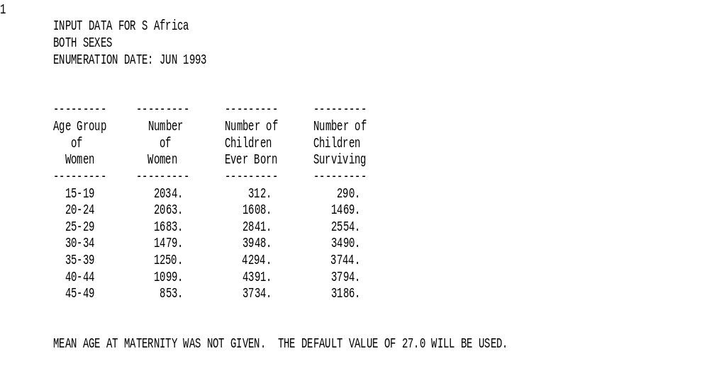
QFIVE’s Reproduction of Input Data for South Africa
Notes:
1. Source of data is the 1993 South Africa LSMS (Wagstaff 2000).

Slide 10
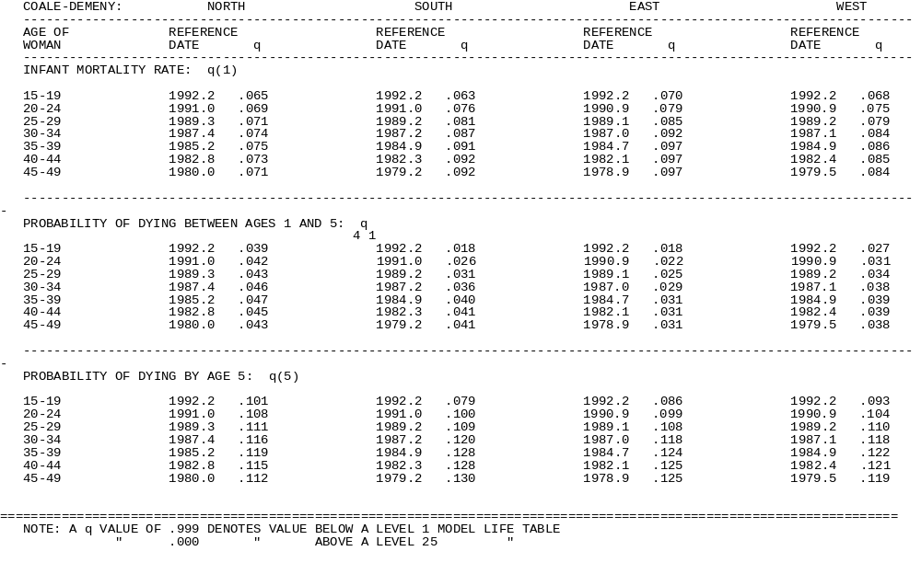
Indirect Estimates of Child Mortality, South Africa
Notes:
QFIVE produces estimates of the IMR, U5MR, and child mortality (mortality between the ages of 1 and 5).
It produces separate estimates for each age group and for each of eight different model life tables. The four shown in table 3.3 are based on the popular Coale-Demeny life tables.
The estimates indicate how mortality rates vary with the age of the cohort—mostly rates are higher the older the cohort. QFIVE indicates the estimated date to which the mortality rate refers, so the estimated rates for different years (see figure below) can be reported (and graphed). Or an average over cohorts can be calculated. If this is done, it is usual to ignore the rates for the two youngest and two oldest age groups on the grounds that they reflect births to young women who are unrepresentative and births that took place more than 10 years before the survey. One option is to take a simple average of the rates occurring in the age groups 25–29, 30–34, and 35–39, though sometimes it may make sense to include at least the rate for the 20–24 age group as well. If the latter group is ignored, the results in the table point toward a U5MR for South Africa of 115–119 per 1,000 for 1987.
Hill and Yazbeck (1994) and Hill et al. (1999) provide guidance for a large number of developing countries on which one of the Coale-Demeny life tables is most appropriate. In this case, if the North model is used, a U5MR (for 1987) of 115 per 1,000 is obtained.

Slide 11
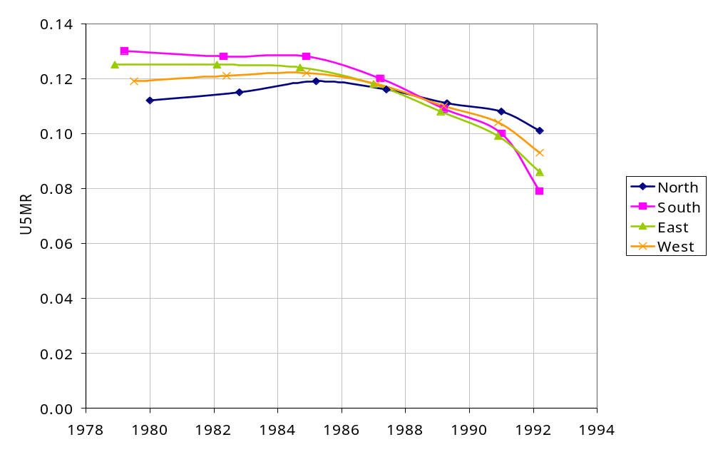
Indirect Estimates of U5MR using alternative model life tables,
South Africa

